Slide 1
A journal continued as a different name (using 780 and 785)
Yoel Kortick – Senior Librarian

Slide 2
A Journal continued as a different name
This relates to the relation of one journal that changed its name and is “continued as” another journal.
The “British Columbia Medical Journal” was originally known as the “Bulletin of the Vancouver Medical Association”.
“British Columbia Medical Journal” was “Preceded by” the “Bulletin of the Vancouver Medical Association”.
Alma uses standard MARC tags to establish the relationships
785 is “Succeeding Entry”
780 is “Preceding Entry”

Slide 3
A Journal continued as a different name
Bulletin of the Vancouver Medical Association
British Columbia Medical
Journal

Slide 4

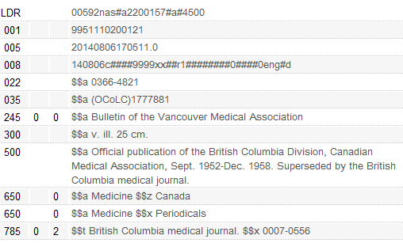
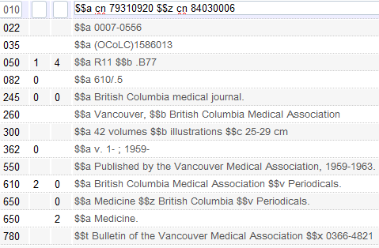
A Journal continued as a different name
The two bibliographic records
The 780 and 785 of each entry points to the succeeding and preceding entry for each journal

Slide 5
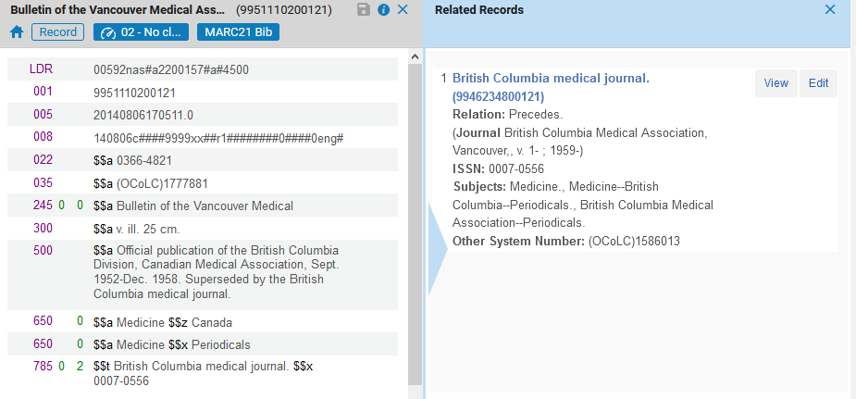
A Journal continued as a different name
Here is the relation in the metadata editor (Precedes)

Slide 6
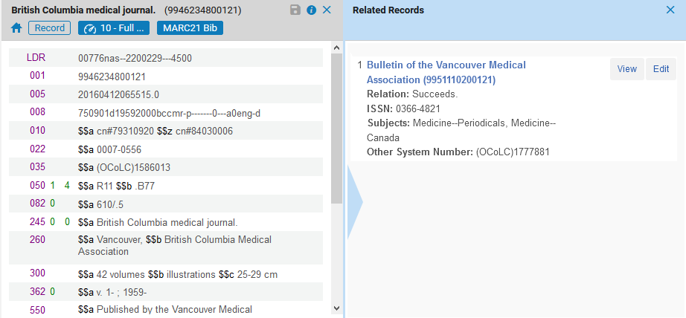
A Journal continued as a different name
Here is the relation in the metadata editor (Succeeds)

Slide 7
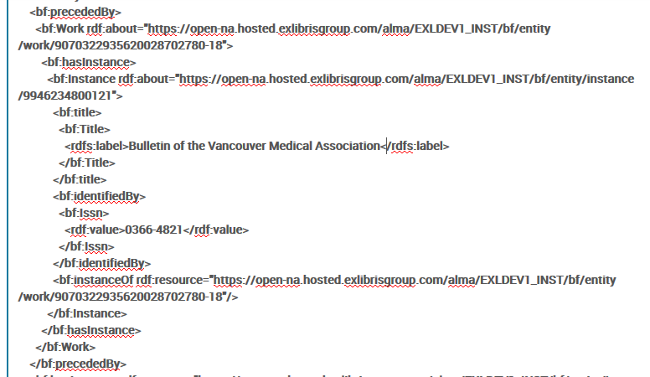
A Journal continued as a different name
Here is the BIBFRAME for Bulletin of the Vancouver Medical Association (preceded by)

Slide 8
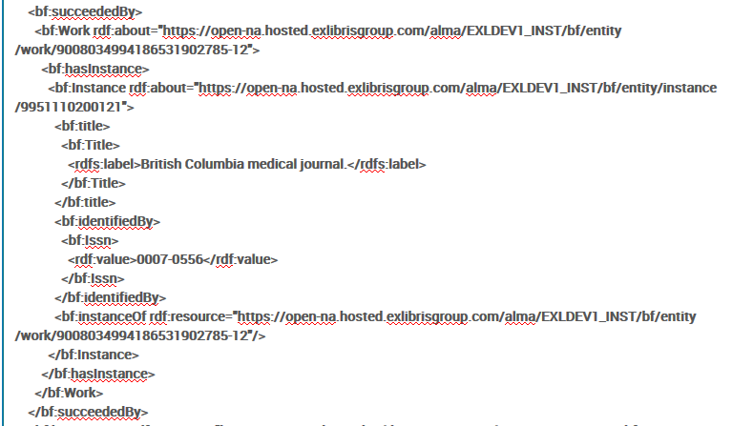
A Journal continued as a different name
Here is the BIBFRAME for British Columbia medical journal (succeeded by)

Slide 9
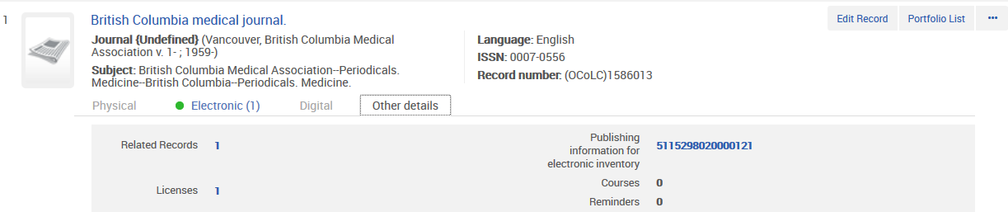
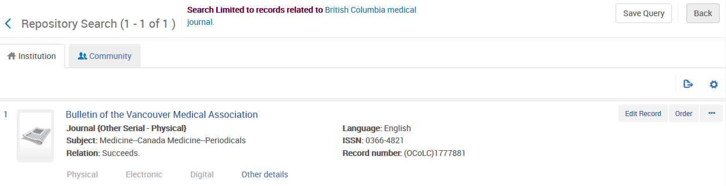
A Journal continued as a different name
Here is the relation in Alma for British Columbia medical Journal

Slide 10
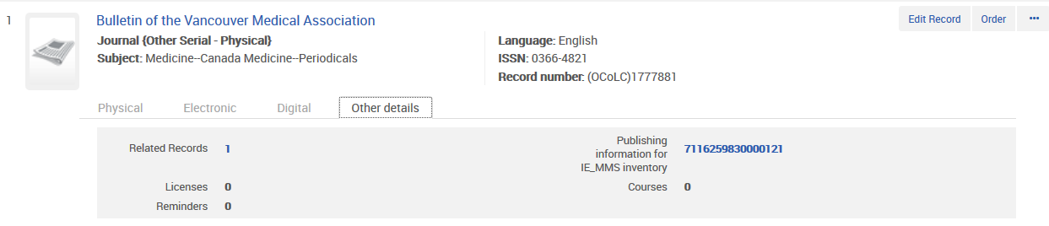
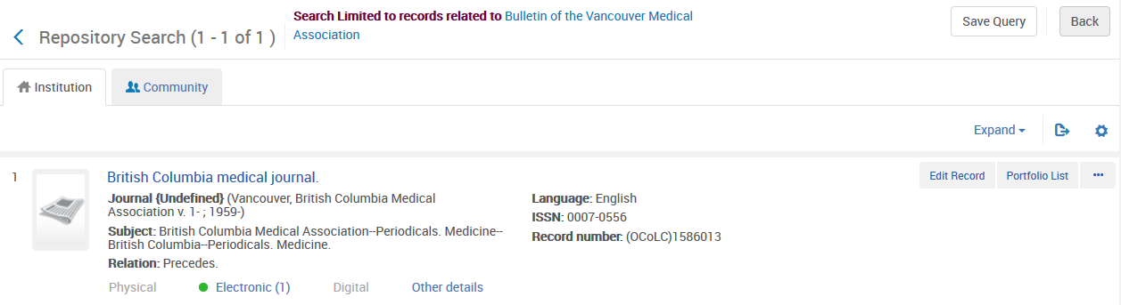
A Journal continued as a different name
Here is the relation in Alma for Bulletin of the Vancouver Medical Association

Slide 11
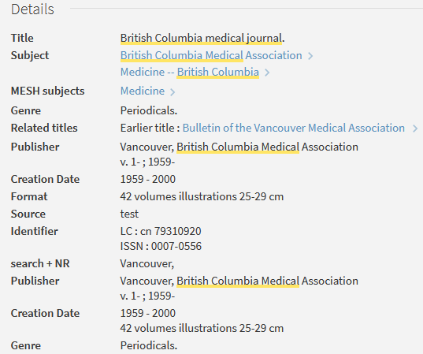
A Journal continued as a different name
“British Columbia medical Journal” in Primo

Slide 12
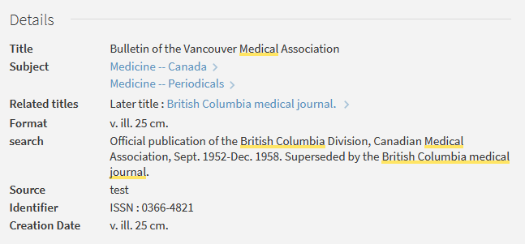
A Journal continued as a different name
“Bulletin of the Vancouver Medical Association” in Primo

Slide 13
xxx@exlibrisgroup.com

